Slide 1


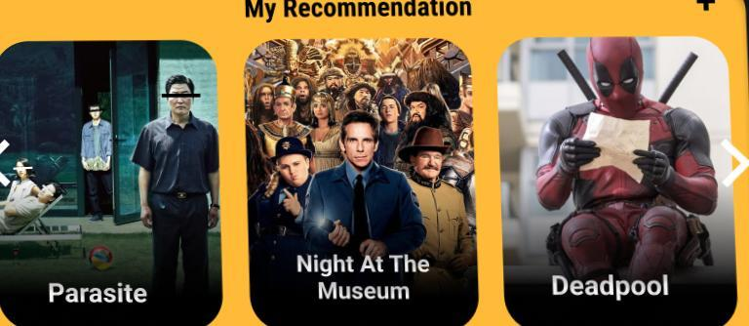
IMDB – MOVIE ANALYSIS
By: Kashish M. Gaikwad

Slide 2
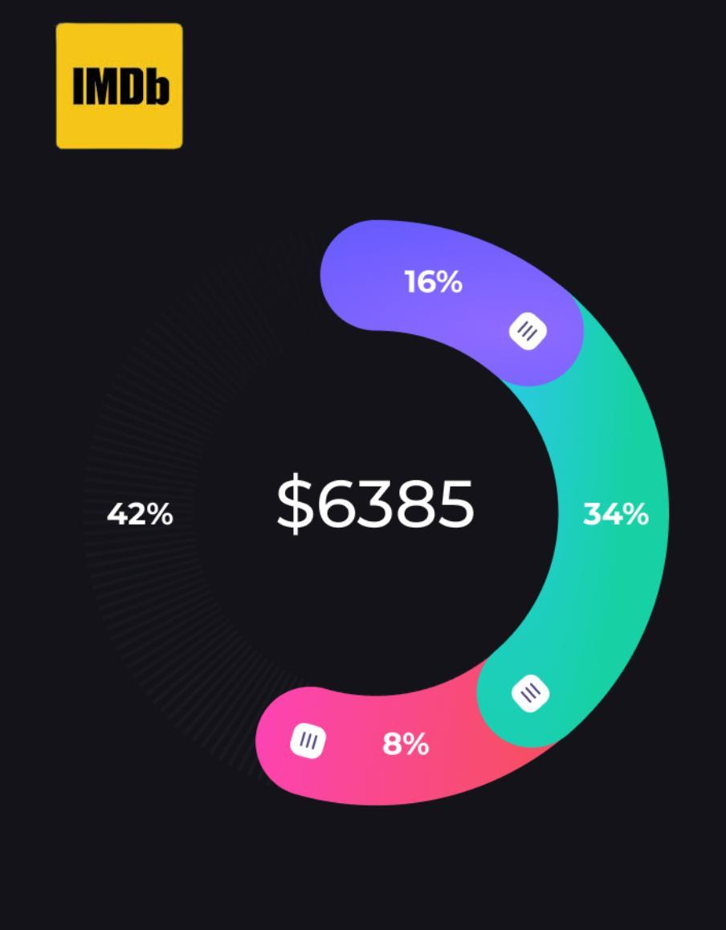
AGENDA
Project Description Approach Tech – Stack Used Insights Results

Slide 3
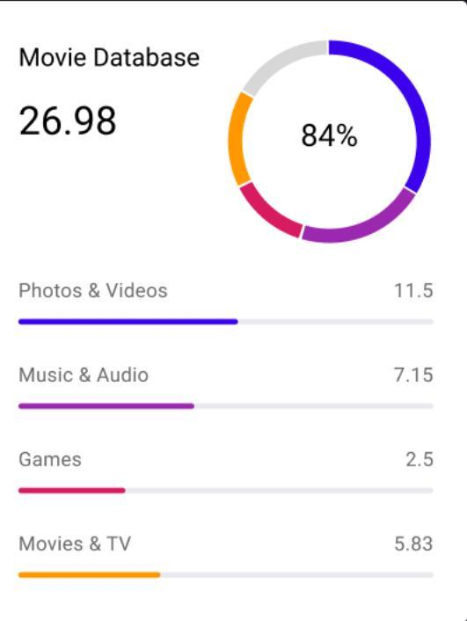
PROJECT DESCRIPTION
The datasets provided is related to IMDB Movies. A potential problem to investigate could be: “What factors influence the success of a movie on IMDB?” Here, success can be defined by high IMDB ratings. The impact of this problem is significant for movie producers, directors, and investors who want to understand what makes a movie successful to make informed decisions in their future projects. The project is all about analysing the dataset having various columns of different IMDB Movies like the movie names, released year, actors, budget, gross, genre etc. Using this we need to analyze the profit, top directors, popular movies number of voted users and other such conclusions. Dataset having 28 columns, 5044 Rows of different Imdb Movies. • Defined a problem, clean the data as necessary remove null and duplicate values. Explore the dataset and derive insights. Use root cause analysis five way's approach. Create chart pivot table and graphs and Give answer to asked questions and create reports for data-driven decision.

Slide 4
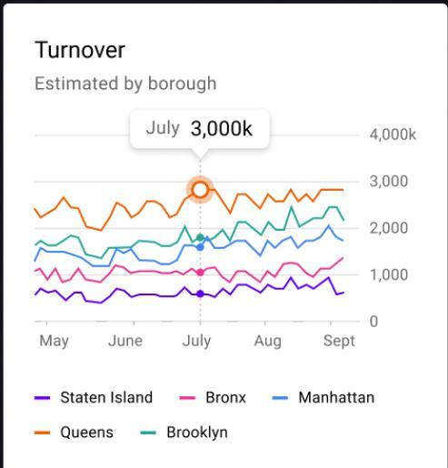
APPROACH
We will be performing our analysis on Microsoft Excel using various in-built formula of Excel and we will go step by step in finding out the answers to the questions asked related to the data set. Then we will look for duplicates in the data set and if any we will remove it through remove duplicate inbuilt function of excel. We will check for missing values in the data set as well. We will check for outliers in the data by using scatter plot.
We will remove the outlier if and draw summary and conclusion about that.

Slide 5



TECH – STACK USED
MS Excel - For graphical representation of the results and to understand the results set better
Microsoft PowerPoint – For presentation of the project

Slide 6

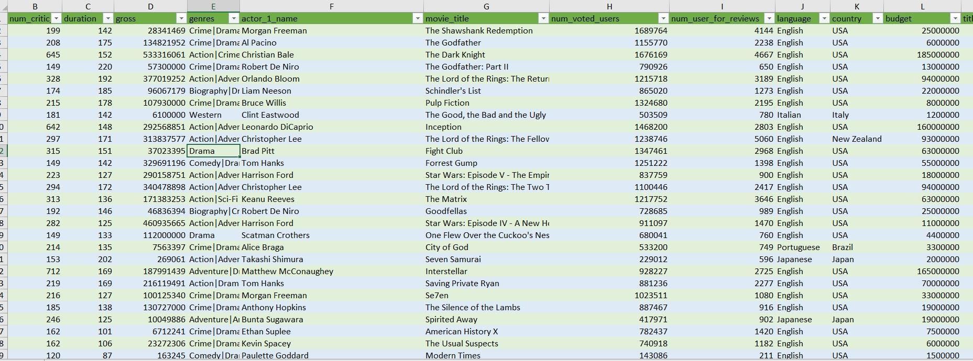
INSIGHTS
Cleaned data
⬇️
The data cleaning process helped ensure the dataset’s quality by addressing missing values, duplicates, and data type issues

Slide 7

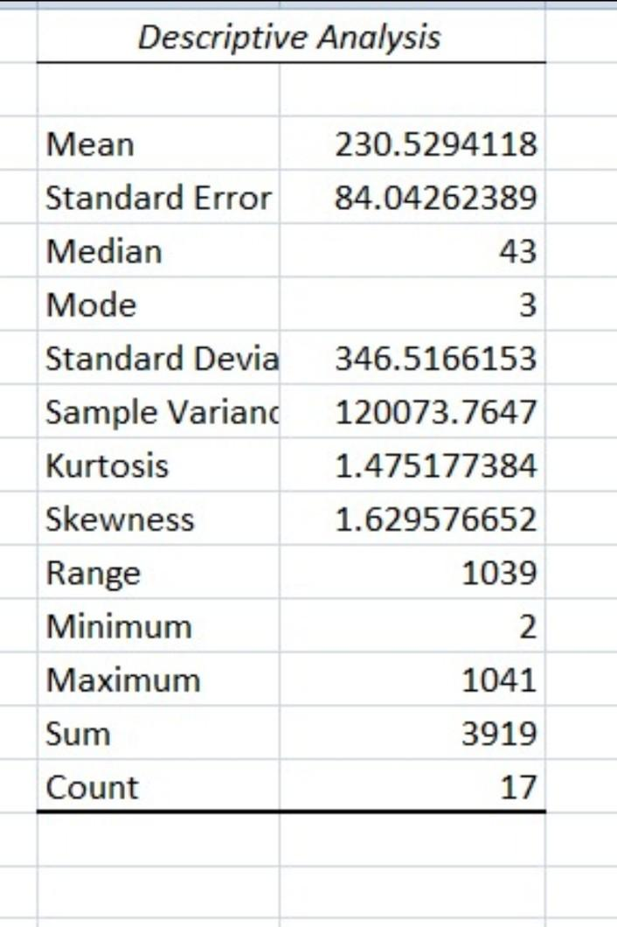
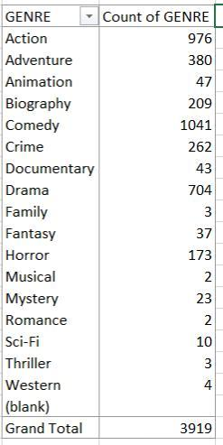
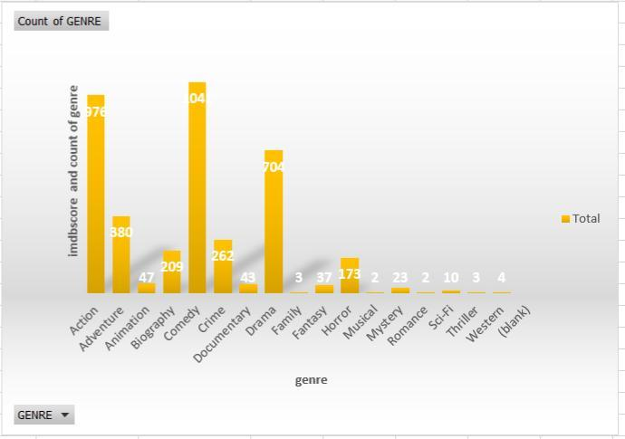
A. Movie Genre Analysis:
Analyze the distribution of movie genres and their impact on the IMDB score. Task: Determine the most common genres of movies in the dataset. Then, for each genre, calculate descriptive statistics (mean, median, mode, range, variance, standard deviation) of the IMDB scores.
➡️
➡️
As we can see that the most common movie genre is ( Comedy1041)
Descriptive analysis

Slide 8

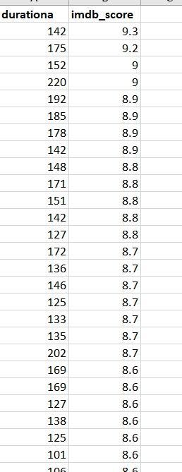
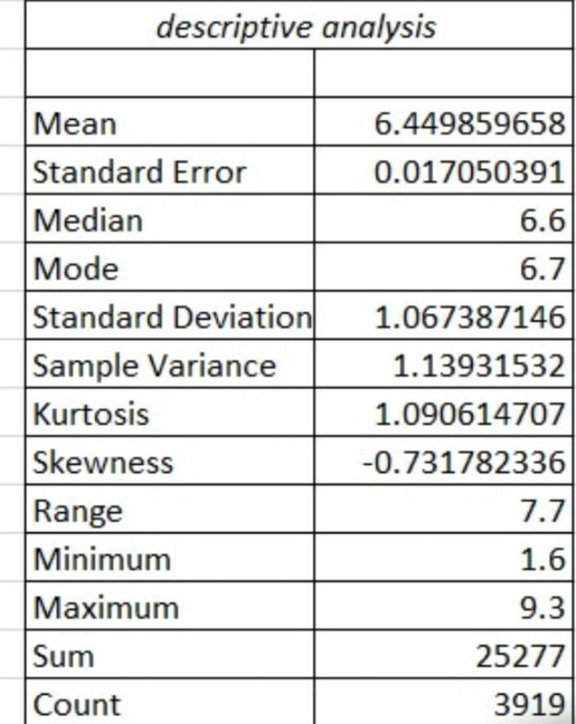
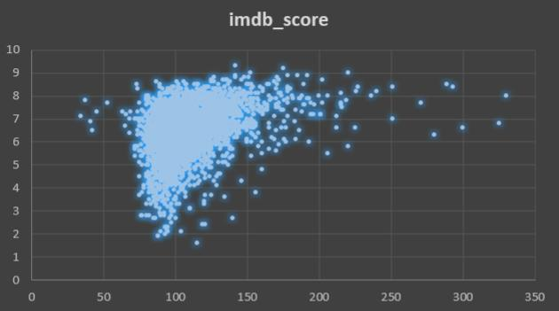
B . Movie Duration Analysis:
Analyze the distribution of movie durations and its impact on the IMDB score. Task: Analyze the distribution of movie durations and identify the relationship between movie duration and IMDB score.
➡️
➡️
Descriptive analysis

Slide 9

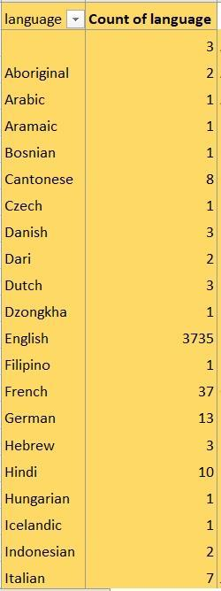
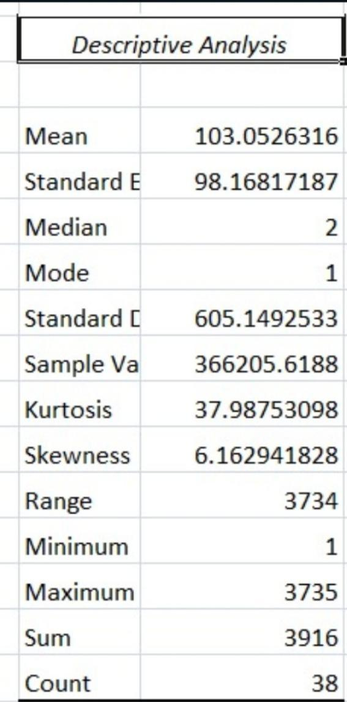
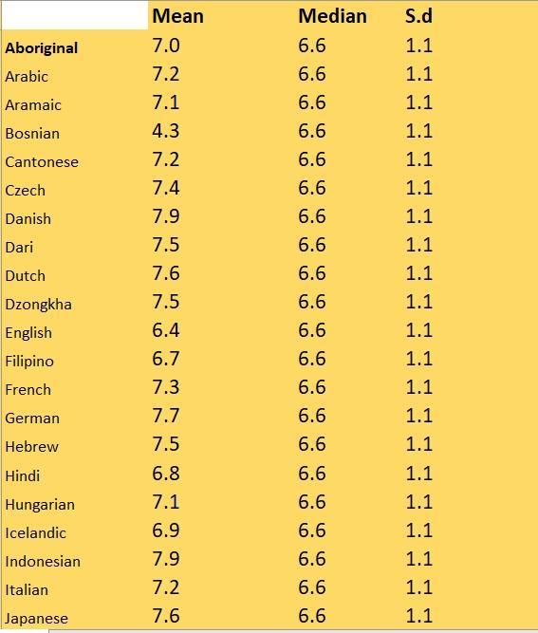
C. Language Analysis:
Examine the distribution of movies based on their language. Task: Determine the most common languages used in movies and analyze their impact on the IMDB score using descriptive statistics.
➡️
➡️
We can see that the most common language is( English at 3735 )
Descriptive analysis

Slide 10

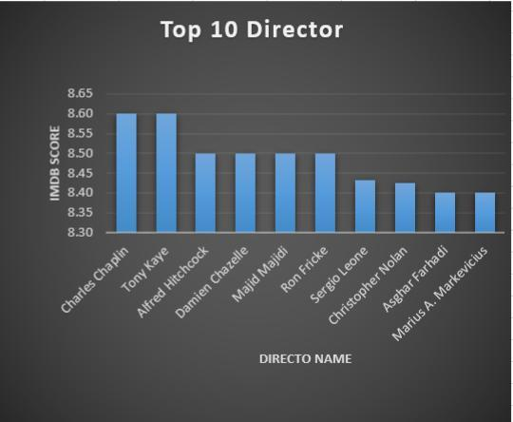
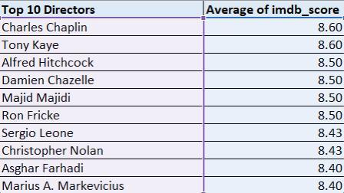

D. Director Analysis :
Influence of directors on movie ratings. Task: Identify the top directors based on their average IMDB score and analyze their contribution to the success of movies using percentile calculations.
➡️
➡️
Top 10 directors with their (IMDB score)
and (percentile calculations)

Slide 11
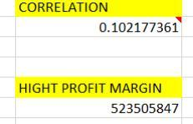
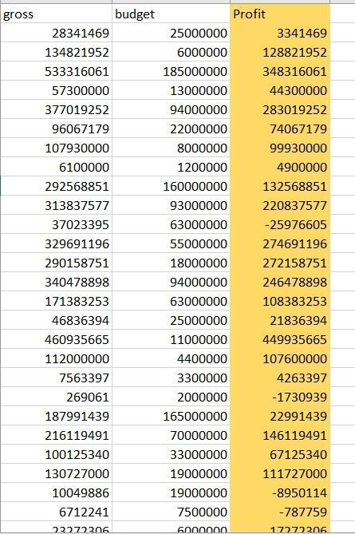
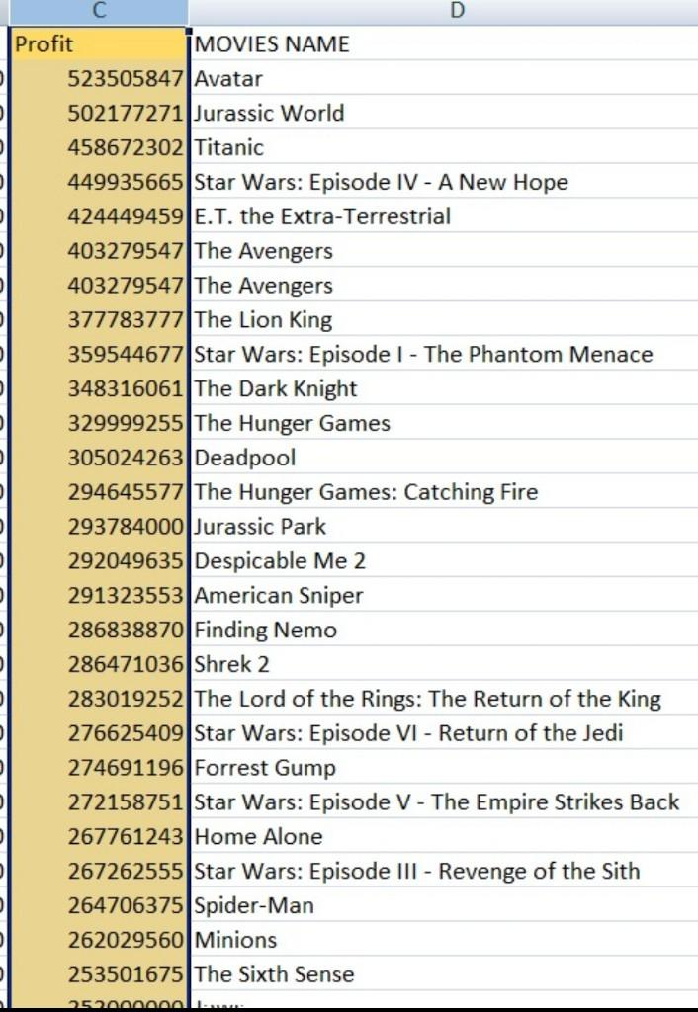
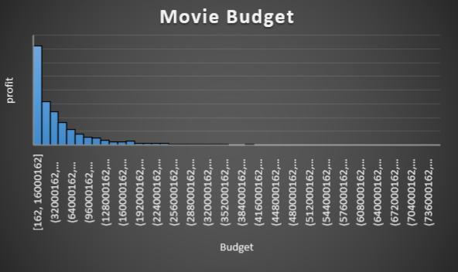
E . Budget Analysis:
Explore the relationship between movie budgets and their financial success. Task: Analyze the correlation between movie budgets and gross earnings, and identify the movies with the highest profit margin.
Movies with High profit margins
➡️
⬆️
➡️
➡️
⬆️
The movie budget is presented through the graph

Slide 12
CONCLUSION
In conclusion, this project provided a deep understanding of the factors influencing the success of movies on IMDB. From data cleaning to the ‘Five Whys’ analysis and the individual data analytics tasks, the insights gained can empower stakeholders in the movie industry to make data-driven decisions, improve movie quality, and enhance audience satisfaction. The project’s comprehensive report encapsulates these insights for easy reference and decision-making.
Thank you

Slide 13
RESULTS
The data cleaning process helped ensure the dataset’s quality by addressing missing values, duplicates, and data type issues. This step laid a solid foundation for subsequent analysis, reducing the risk of biased or inaccurate results.
We found that the most common movie genres in the dataset (comedy 1041 ) and language is (English 3735)
Calculating descriptive statistics for each genre’s IMDB scores revealed variations in ratings across genres.
Analysis of movie durations and IMDB scores revealed a mild positive correlation. Longer movies tended to have slightly higher IMDB ratings.
Top directors with consistently high average IMDB scores were identified. Comparing these directors’ scores to the overall distribution highlighted their significant impact on movie success.
Correlation analysis showed a moderate positive relationship between movie budgets and gross earnings ( 0.102177361 )
Movies with the highest profit margins were identified ( 523505847 )
With this calculated results the Investors ,Stake holders , Producers can watch work and invest Target Collab and take proper decision in growing their business

Slide 14

EXCEL SHEET

